Slide 1

WAY TO ENTERPRISE
Pakage 1: Database

Slide 2
WAY TO ENTERPRISE
Lesson 7

Slide 3
Agenda
Session & Connection
Variable
Trigger
Index
CASE WHEN
Assignments
Copyright © VTI Academy All Rights Reserved

Slide 4
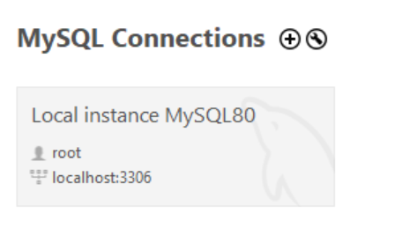
Connection

Slide 5
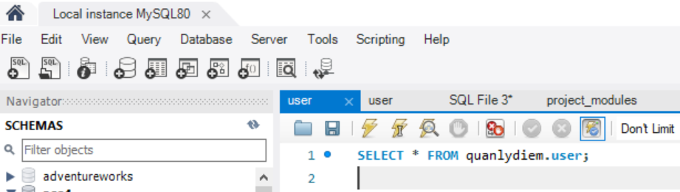
Session
A session is just a result of a successful connection

Slide 6
Variable
User-defined variable
System variable

Slide 7


User-defined variable
Local
  A scope variable that can only be used in functions, store procedures and triggers
Global
  A scope variable that can be used in all SQL
Session
  A scope variable that can only be used in a session

Slide 8
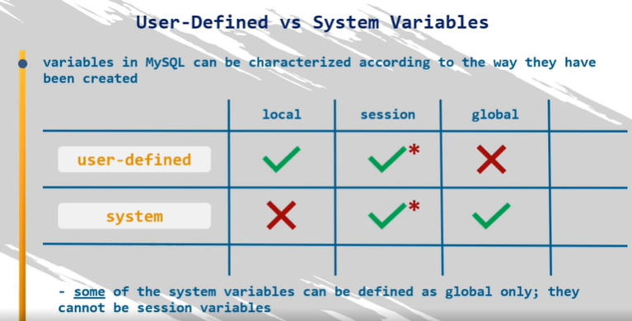
System variable
A variable whose scope can be used in all SQL (created by SQL).
The system variable can only be session or global

Slide 9
Trigger
Trigger
  Automatically execute SQL commands or Store Procedure BEFORE | AFTER the INSERT, UPDATE, or DELETE commands.
  Trigger is a special type of Store Procedure
Aim
  Checking the integrity, logical errors of the database
  Checking constraints, complex default values
  Controlling changes to data in a table

Slide 10
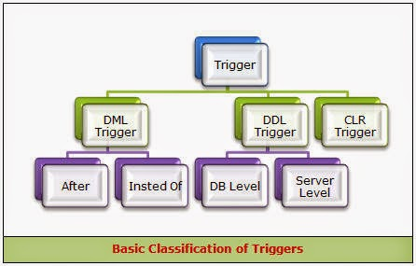
Trigger Type

Slide 11
DML Trigger
Before
After

Slide 12
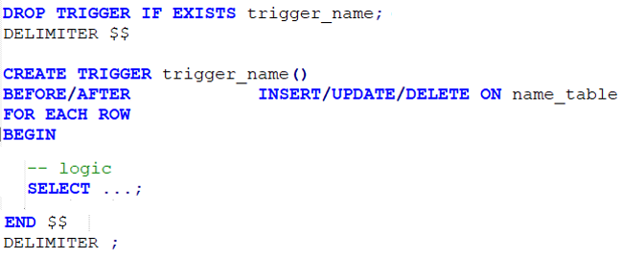
Syntax
Create
Disable / Enable
Drop

Slide 13
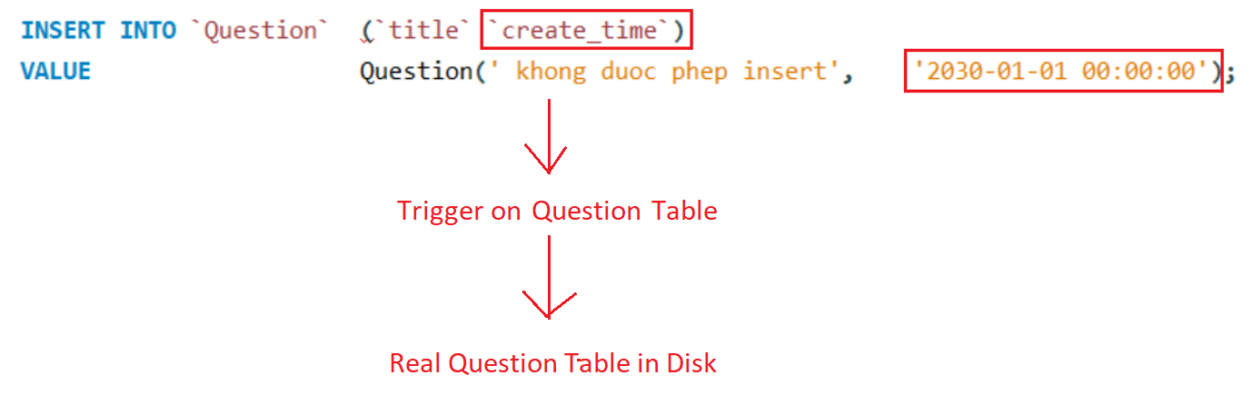
Flow
Before
Verify data

Slide 14
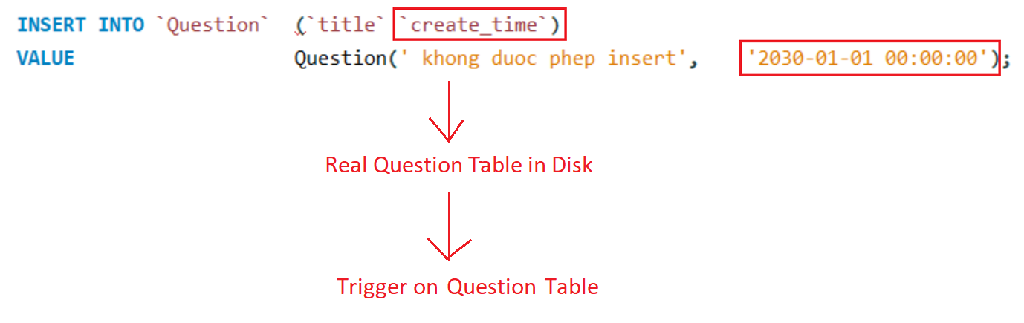
Flow
After

Slide 15
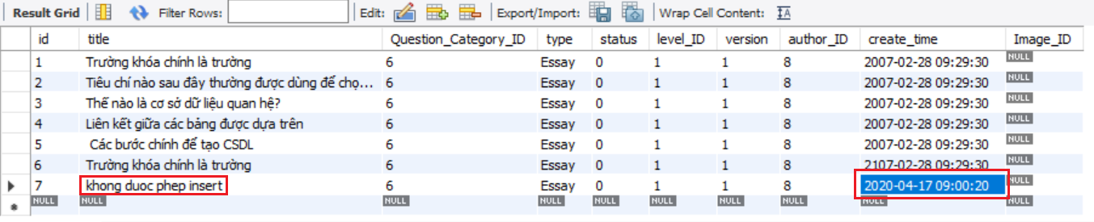
Example 1 (Before)

Slide 16
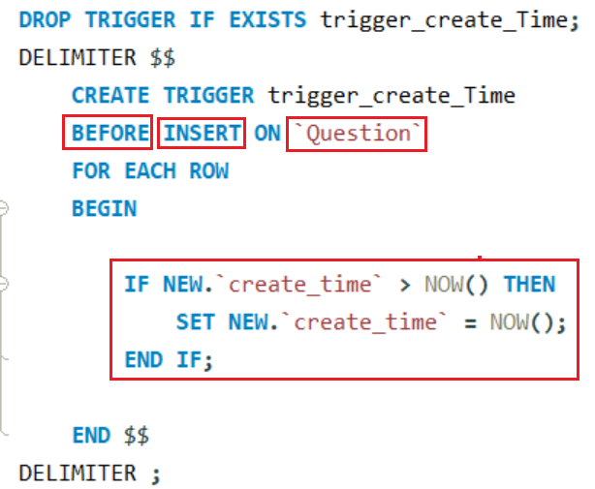
Example 1 (Before)

Slide 17
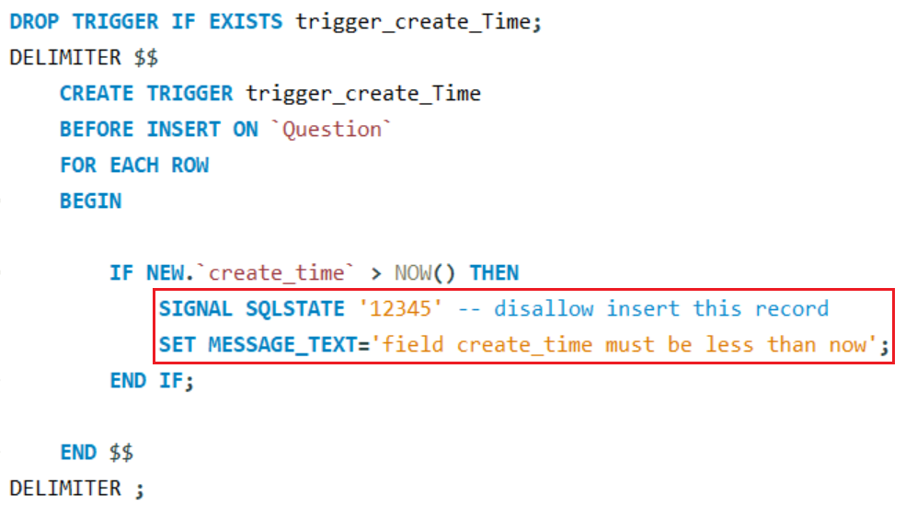
Example 2 (Before)

Slide 18
Example 2 (Before)

Slide 19
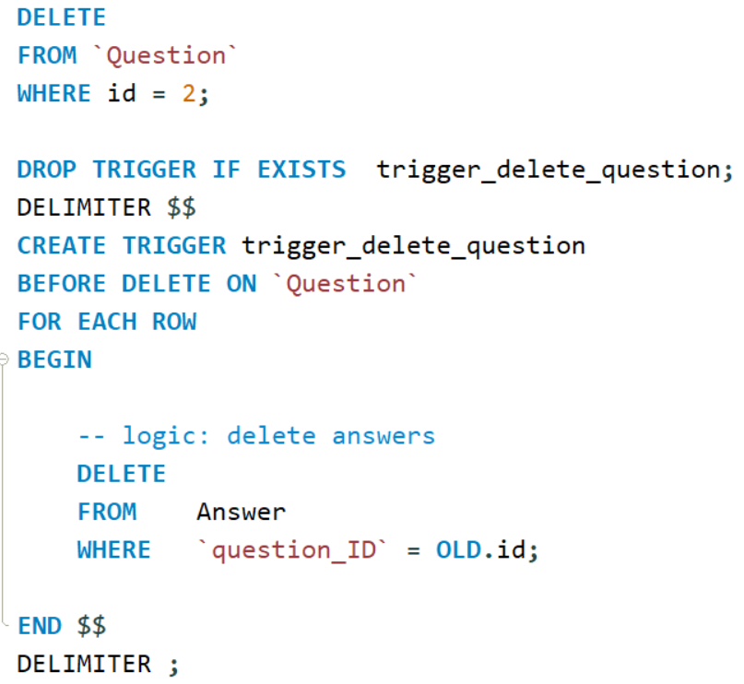
Example 3 (Before)

Slide 20
Example 3 (After)
Delete Question which has id = 6 (without using on delete cascade)

Slide 21
Index
Like catalog of books
Create

Slide 22
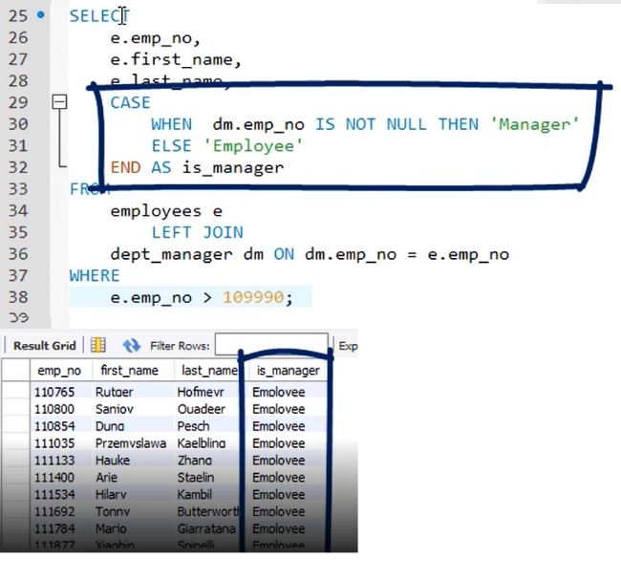
CASE WHEN
Like switch case in language programming (Java, C, C ++)
Using filter data

Slide 23
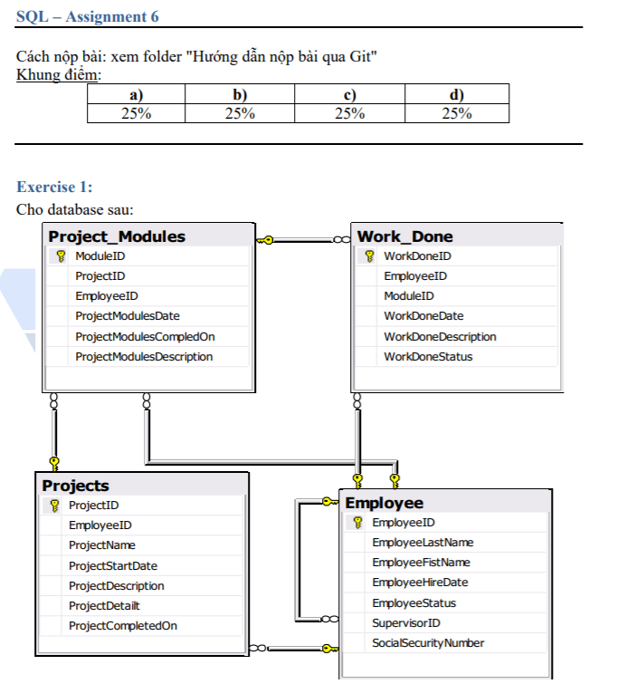
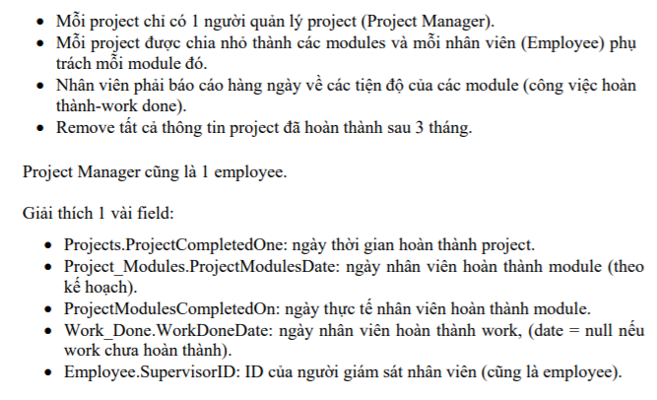
Assignments 1

Slide 24
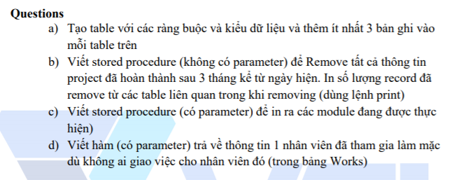
Assignments 1

Slide 25
Assignments 2
Assignments for Testing System

Slide 26
Q & A
Copyright © VTI Academy All Rights Reserved

